Slide 1
CYK Algorithm for String Membership

Slide 2
CYK Algorithm
Discovered by Cocke, Younger, Kasami during 1965-67.
Used to identify ,possible set of strings that can be generated by CFG.
The grammar needs to be in CNF first.
This ensures that the rules are simple. Rules are of the form X → a or X → YZ
A procedure to perform this function is called a parsing algorithm or parser.
Consider all substrings of len 1 first. See if these are in language. Next try all len 2, len 3, …. up to length n.

Slide 3
Construct a Triangular Table
Each row corresponds to one length of substrings –
Bottom Row – Strings of length 1 .
Second from Bottom Row – Strings of length 2 .
Top Row – string ‘w’

Slide 4
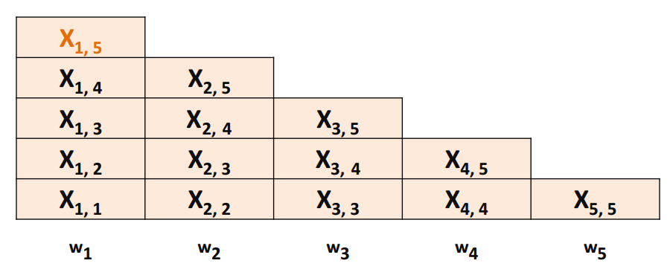
Construct a Triangular Table

Slide 5
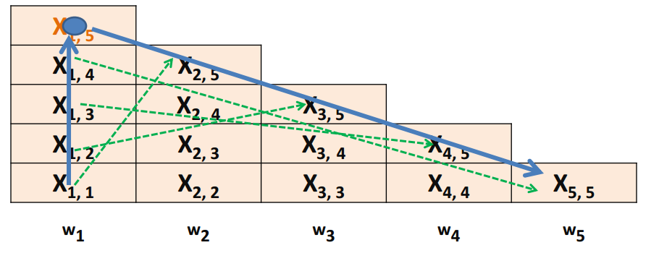
Use pairs to compare

Slide 6
Example CYK Algorithm
Show the CYK Algorithm with the following example: – CNF grammar G •
S -> AB | BC •
A -> BA | a
B ->CC | b
C -> AB | a
w is baaba – Question Is baaba in L(G)?

Slide 7
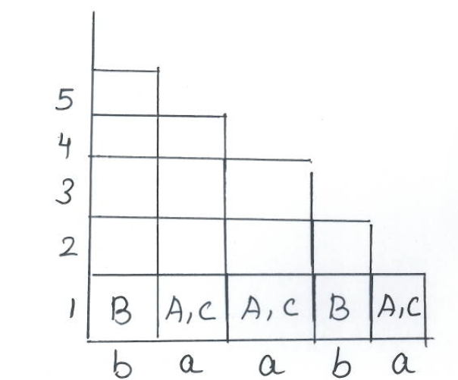
Step 1:Construct a triangle
Step 1: Split the string with one letter
b-> B
a->A,C
Fill the row 1 in triangle with respective rules

Slide 8
Step 2:CYK Algorithm
Step 2:Split the string with two letter combination
i)ba ii)aa iii)ab iv)ba
Consider i) ba
Assign rules
b a -> {B} {A,C}
Find Cartesian product for the set {B} {A,C}
Cartesian product BA,BC
Substitute rules for BA ,BC
BA->A BC-> S
Result {A,S} Fill in the row-2,col-1 in the triangle

Slide 9
Step 2:CYK Algorithm
Consider ii) aa
Assign rules
a a -> {A,C} {A,C}
Find Cartesian product for the set {A,C} {A,C}
Cartesian product {AA} {AC} {CA} {CC}
Substitute rules for {AA} {AC} {CA} {CC}
AA>No rule AC-No rule CA-No rule CC-B
Result {B} Fill in the row-2,col-2 in the triangle

Slide 10
Step 2:CYK Algorithm
Consider ii) ab
Assign rules
a b -> {A,C} {B}
Find Cartesian product for the set {A,C} {B}
Cartesian product {AB} {CB}
Substitute rules for {AB} {CB}
AB>S,C CB-No rule
Result {S,C} Fill in the row-2,col-3 in the triangle

Slide 11
Step 2:CYK Algorithm
Consider i) ba
Same Result {S,A}
Fill in the row-2,col-4 in the triangle

Slide 12
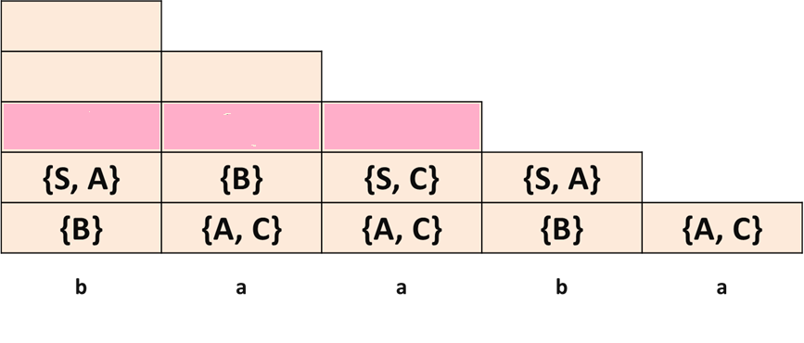
Step -2 Output

Slide 13
Step 3:CYK Algorithm
Step 3:Split the string with three letters combination
i)baa ii)aab iii)aba
Consider i) baa
Assign rules by splitting baa with 1:2 and 2:1 ratio
ba a ->{A,S} {A,C}
b aa ->{B} {B}
Find Cartesian product for the set AA,AC,SA,SC
Find Cartesian product for the set {S,C} {S,C}
Cartesian product SS,SC,CS,CC
Substitute rules for BB,SS,SC,CS,CC
BB-> No rule SS- > No rule SC-> No rule CS-> No rule CC-> No rule
Result {-} Fill in the row-3,col-1 in the triangle

Slide 14
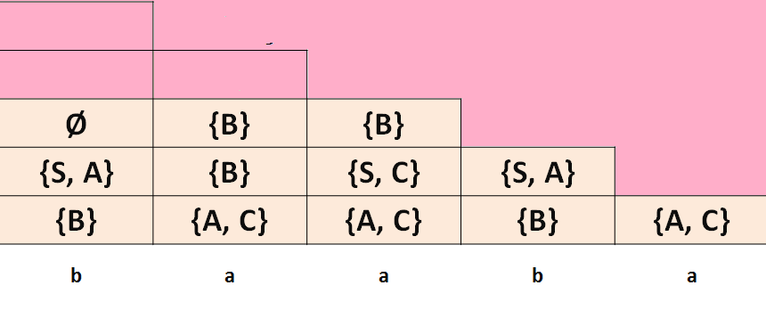
Step 3 Output

Slide 15
Step 4:CYK Algorithm
Step 4:Split the string with four letters combination
i)Baab ii)aaba
Consider i) baab
Ba ab -> {S,A} { S,C} -> SS,SC,AS,AC {no rule}
B aab - { b } {b} -> no rule
Baa b - { null} {b} - {null}
Result – {-}

Slide 16
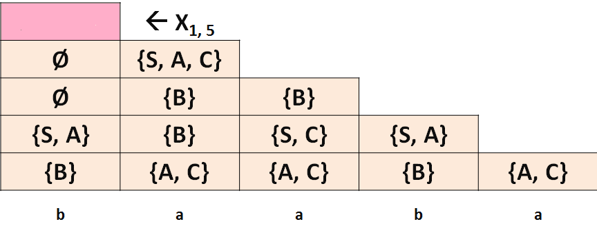
Output for Step 4

Slide 17
Step 5:CYK Algorithm
Step 4:Split the string with five letters combination
Baaba
Split
Ba aba -{S,A} {B} -> {SB, AB} -> {S,C}
Baa ba -> {null } { S,A } -null
B aaba -> {b } { S,A,C} - { bs,ba,bc} -{ A,S}
Baab a -> { null } { A,C}
Result : { S,A,C}

Slide 18
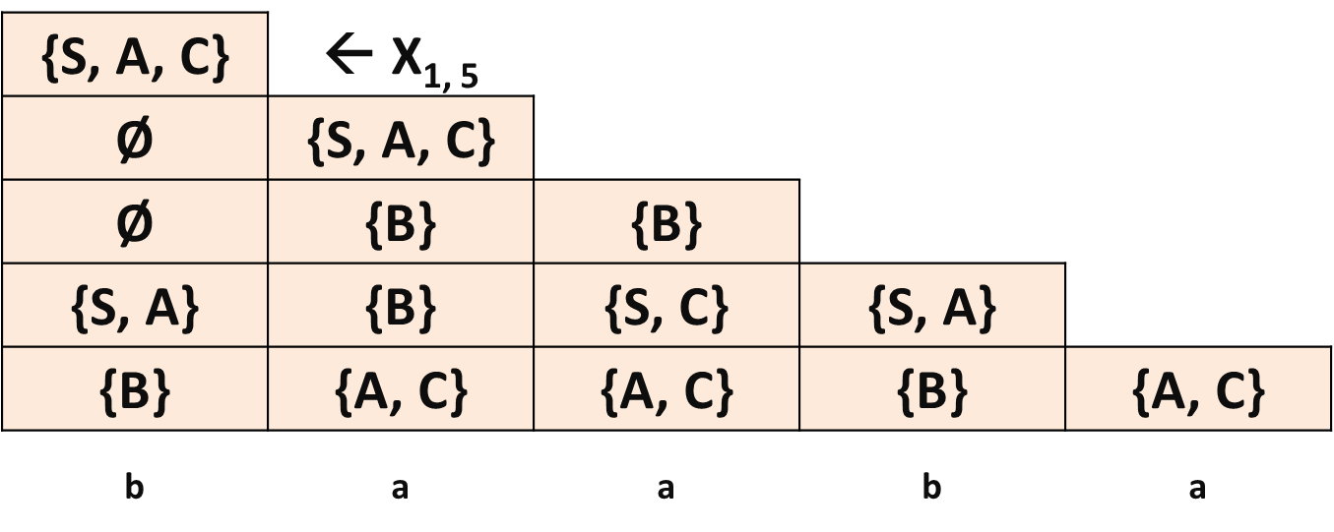
Output for Step 5
The CYK Algorithm correctly computes X _{i j} for all i and j; thus w is in L(G) if and only if S is in X_{1n}.

Slide 19
References
J. E. Hopcroft, R. Motwani, J. D. Ullman, Introduction to Automata Theory, Languages and Computation, Second Edition, Addison Wesley, 2001
T.A. Sudkamp, An Introduction to the Theory of Computer Science Languages and Machines, Third Edition, Addison Wesley, 2006

